Slide 1
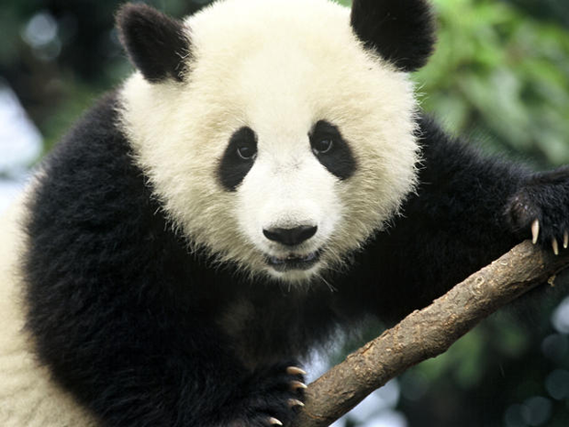
SOCIAL ISSUE PROJECT: ANIMAL AWARENESS
SAVE THE ANIMALS!
Conservationists need your help! Animals are becoming endangered and even going extinct!
They need you to design a flip-book app that will raise awareness for an endangered animal that YOU select.
You will have to do some research about your animal!
Then you will create and design a flip-book and fill it with all of your information you’ve learned.
Raising awareness, learning how we can save animals, and protecting the environment is more important than ever!
Be creative, use your imagination, and design the best app that can show people what kinds of amazing animals need our help around the globe.

Slide 2
FLIP BOOK APP PROJECT
You will be given a booklet and each page will contain two parts:
The top half: RESEARCH.
-This will be for research purposes and students can write down information they find. It’s also for notes.
The bottom half: APP.
-This side will be for students to take the research and create a page for the app based on the content they find.
Students will also create an app cover, table of contents, and a credits page. The app may be created vertically or horizontally. There will be blank pages included for students that would like to add even more.
I would highly suggest using the website WWF.org when completing this project. They have an expansive list of animals and information listed here: SPECIES LIST

Slide 3
When you complete an app page, you will cut out the phone or app screen from each page.
This page has two screens to cut out, but most pages only have one.
Once all your pages are complete, you will put them in the correct order.
The order of the content is up to you, just make sure that it matches your Table of Contents

Slide 4
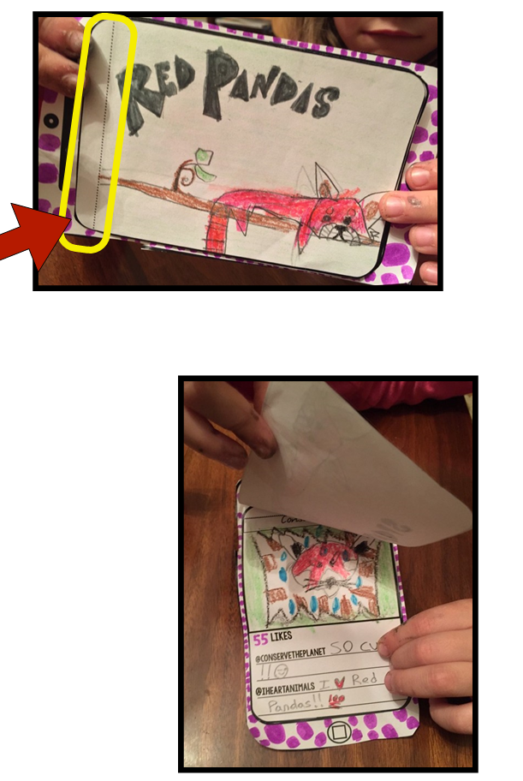
RUBRIC
Glue the edges above the dotted lines ONLY!
Then you can flip your app back and forth sharing all the information you’ve learned.

